Slide 1


FEMA’S FLOOD INSURANCE POLICY DATABASE
AIT622-004
Narasimha Krishna Amruth Vemuganti - G01389960 Kaushik Prayaga - G01354233
Tharuni Myda - G01393733 Jaswanth Erusu- G0137621611

Slide 2
Contents
➢
Introduction
Strategy
Stakeholders
➢
Data Privacy, Quality and Other issues
➢
Requirements
➢
Metadata
➢
Statistical Analyses and Descriptive Statistics
➢
Correlation and Regression Analyses
➢
Visualizations
➢
Time & Effort and Benefits

Slide 3
Introduction Phases in Strategy Requirements

Slide 4

Introduction
●
The FEMA’s Flood Insurance Policy dataset includes more than 50 million transactions for flood insurance policies with various fields concerning anonymous flood policy holders.
●
Information provided includes building elevation, flood zone rating, zip code, county code, census tract, state code, city code, building type, business type, flood insurance deductibles, total insurance coverage, and total insurance premium.

Slide 5
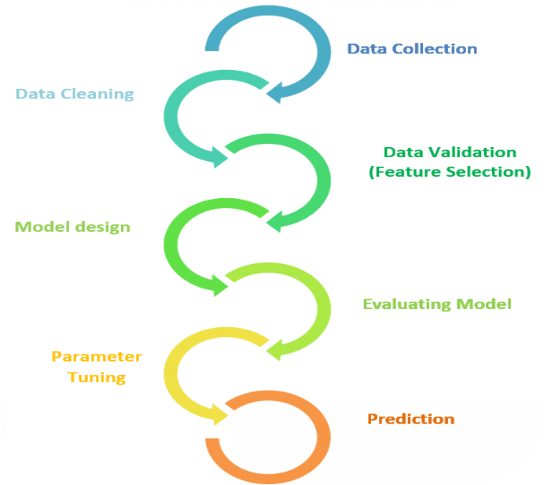
Phases in Strategy
Data Pre-processing
Exploratory Data Analysis
Statistical Analyses and Visualizations

Slide 6

Our Proposed Strategy: Utilizing the FEMA National Flood Insurance Policy Database
●
Data pre-processing involves cleaning, filtering, and transforming the dataset. Exploratory data analysis includes descriptive statistics, graphics, and grouping analysis
Machine learning models will employ gradient boosting, decision trees, and random forests to predict flood hazards
●
●

Slide 7
Stakeholders

Slide 8

Stakeholders for this project
Stakeholders for the FEMA National Flood Insurance Policy Database can be defined as individuals or groups who have an interest or are affected by the data and its usage.

Slide 9
Stakeholders for this project
FEMA (Federal Emergency Management Agency)
Real Estate
Insurance Companies
Taxpayers and Property Owners
Federal and State Agencies
Emergency Response Teams
Academic Institutions

Slide 10

Data privacy, Quality and Other issues

Slide 11
Data privacy, Quality and other issues
The FEMA National Flood Insurance Policy Database contains personally identifiable information, which could lead to privacy concerns.

Slide 12
Data privacy, Quality and other issues
Privacy Concerns: Personally identifiable information (PII) about policyholders
•
Quality Issues: Inconsistent data across many variables and missing values can impact the precision
•
Data Security Concerns: The dataset's public accessibility can make it vulnerable to intrusion attempts leading to the misuse of sensitive information.
•
Legal and Geographical Coverage Issues: Releasing the dataset may violate the 1974 Privacy Act, that protects individuals' personal data

Slide 13
Requirements
People
Software & Hardware
Build vs Buy Approach
Data scientists, data engineers and subject matter experts are needed depending on the size of the project.
Strong CPU and Lots of RAM
Building the necessary infrastructure in-house can be time-consuming and expensive
Large SSD or HDD.
Big data technologies like Apache Hadoop and Apache Spark are available.
Purchasing cloud-based solutions like Amazon Web Services or Google Cloud Platform can be an alternative
NumPy and Pandas are used for data cleaning and preprocessing.
Matplotlib and Seaborn are used for visualization.

Slide 14
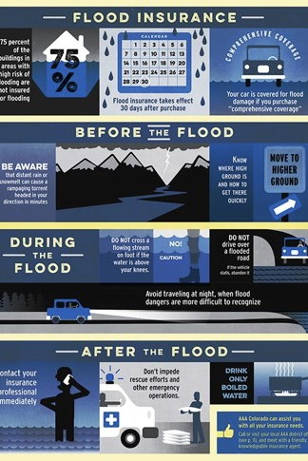
Metadata
The FEMA NFIP Flood Insurance Dataset contains over 2 million rows and 45 columns. The dataset contains multiple fields with giving the demographic, financial and economic related information regarding the policy holders in the United States.
Zip code, county code, census tract, state code, city code - geographic markers that specify the assets’ and the policyholder's whereabout.
Building Type - The sort of property that the consumer owns and protects against flood damage is referred to as the building type.
Business Type- The kind of company that owns and manages the building that the flood insurance policy covers.
Flood Insurance Deductibles- Flood insurance deductibles refer to the amount of money that the policyholder must pay . Total Insurance Coverage- The utmost sum that a policy of insurance will reimburse its insured, in the case of flooding.
Total Insurance Premium- The whole amount of monetary value that customers spend on their insurance company to get flood protection
Census tract- statistical divisions that are revised before every decennial survey inside a county or comparable group. Geocoding system is used by the NFIP (National Flood Insurance Program) to allocate census tract codes.

Slide 15

Statistical Analysis
•
The FEMA NFIP Flood Insurance Dataset is a rich source of information for exploring the relationships between flood risk, insurance coverage, and policyholder characteristics.
•
Descriptive Statistics, Correlation Analysis and Regression Analysis.
•
To make sense of the data, appropriate statistical analysis techniques need to be employed to identify patterns and trends within the dataset.

Slide 16
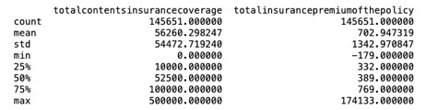
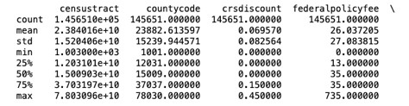
Descriptive Statistics
The descriptive statistics for the numerical fields include count, mean, standard deviation, minimum, maximum, and quartiles. The descriptive statistics for the category columns, however, provide a count of frequencies and percentages.

Slide 17
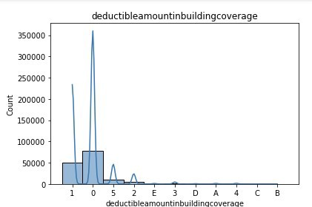
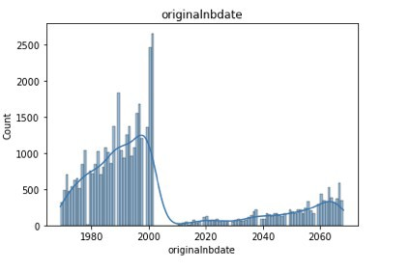
In the categorical attributes, the frequency measure and proportion for each class are calculated. The numerical fields might be represented by histograms, while the categorical columns are by count plots.

Slide 18
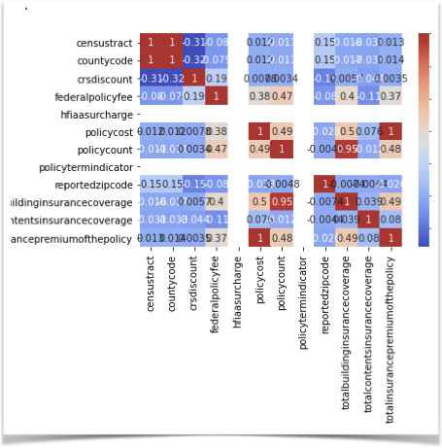
Correlation Analysis
Correlation analysis is a statistical technique used to examine the strength and direction of the linear relationship between two variables.
The correlation coefficient is a measure of this relationship, with values ranging from -1 to 1. A value of -1 indicates a perfect negative correlation. A value of 1 indicates a perfect positive correlation. A value of 0 indicates no correlation between the two variables.
The other values represent the correlation between pairs of variables. For example, the correlation coefficient between 'censustract' and 'countycode' is 0.995578, indicating a strong positive correlation between these two numerical variables

Slide 19
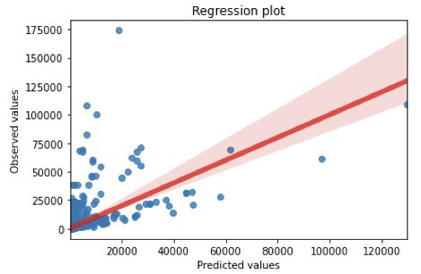
Regression Analysis
Regression analysis can be applied to the dataset if you are interested in exploring the relationship between one or more independent variables and a dependent variable.
•
For instance, we may model the link between the overall insurance premium and the construction insurance coverage and contents insurance coverage using logistic regression, Poisson regression, or linear regression.
•
Overall, the plot suggests that there is a positive relationship between the total insurance premium and the total building insurance coverage and total contents insurance coverage.

Slide 20

Visualizations
What is Data Visualization?
The depiction of data in a visual or graphical manner is referred to as data visualization. It is the transformation of raw data into visually intelligible and interpretable representations such as charts, graphs, maps, and diagrams.
Applications of Data Visualization
•
People can use data visualization to uncover patterns, correlations, and trends that may not be obvious when looking at raw data. It also aids in communicating complicated information in an easy-to-understand and interpret fashion. Data visualization is extensively utilized in a variety of industries such as business, research, engineering, and media.

Slide 21
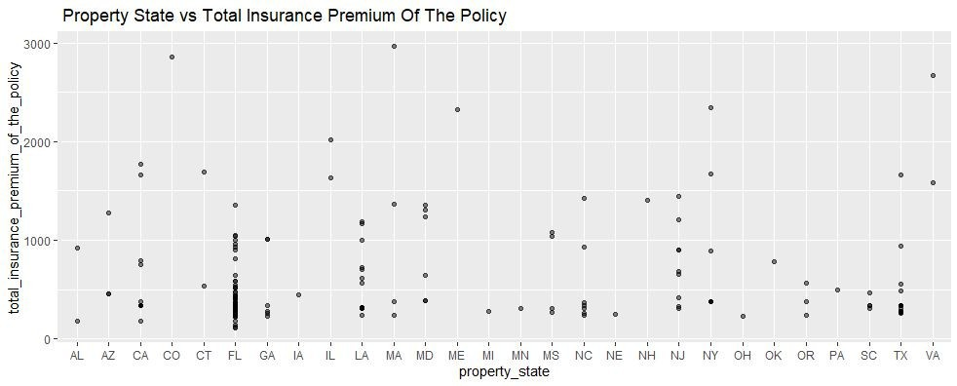
Graphical Representation
Graph axis ( point plot )
•
•
x="property_state", y="total_contents_insurance_coverage“
•
Title="Property State vs Total Building Insurance Coverage"

Slide 22
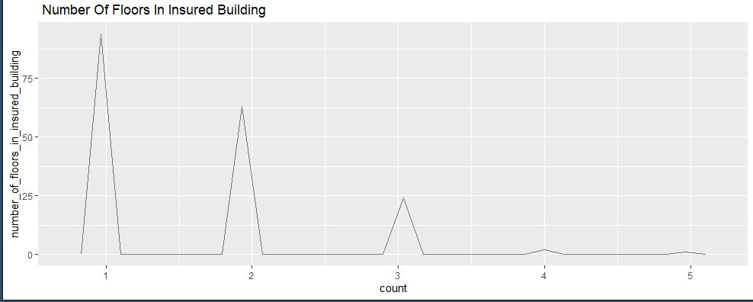
Graphical Representation
Graph axis (freqpoly plot )
•
•
x="count" y="number_of_floors_in_insured_building“
Title=" Number Of Floors In Insured Building"

Slide 23
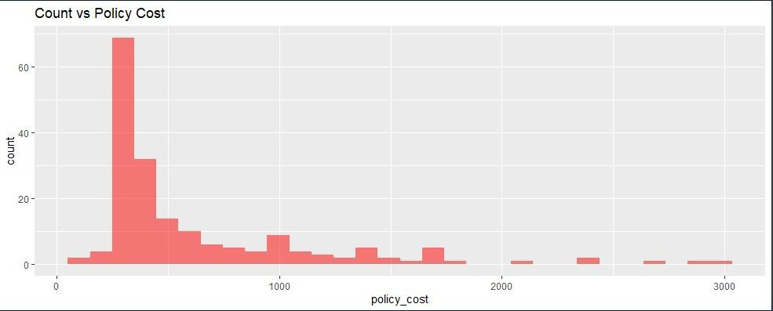
Graphical Representation
Graph axis ( bar plot )
•
•
x="property_state“ y="total_insurance_premium_of_the_policy “
Title="Count vs Policy Cost"

Slide 24
Estimate the time/effort required for the study
•
Data Cleaning and Pre-processing for the subset of the data we took was around 2-3 weeks.
Data Exploration and Analysis: Depending on the dataset, this stage included techniques such as descriptive statistics, data visualization and Regression Analysis which took 4 weeks.
In the future if more work or analysis like ML models and accurate predictions, need to be conducted on the whole dataset , it might probably take over a year of time considering it will be handled by a proper technical team.
•
•

Slide 25
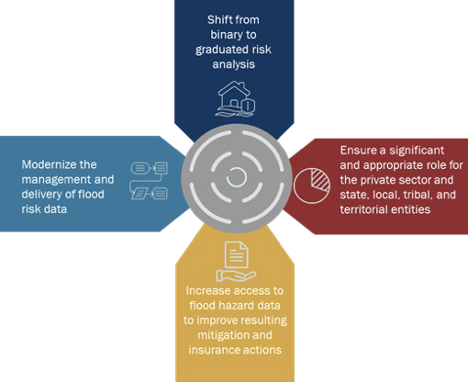
Anticipated Benefits and Values
The dataset can provide insights into the demographics of the customers, their properties, and their insurance coverage. This information can be used to tailor the company's products and services to better meet the needs of their customers.
•
By analysing the claims data, the company can identify the areas that are most prone to flooding and adjust its underwriting policies accordingly. This can help the company in reducing its exposure to risks and improving its risk management practices.
•
Various building kinds, commercial enterprise types, and geographic locations. With this information, the company will be better able to assess the risks connected to various kinds of properties and enterprises and take the necessary precautions to reduce such risks.

Slide 26

Thank you!

